Slide 1
Welcome to E.S.H.S. P.O.T.A.T.O.E.S. Robotics Club!

Slide 2
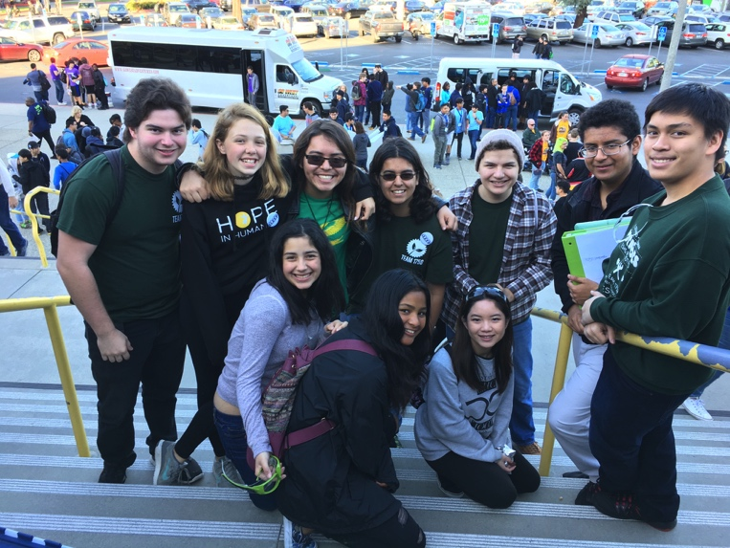
About the Robotics Club
The club is comprised of a group of people that love to work with robots!
Club members work in various groups and compete among one another to build the best robot by using teamwork and collaboration
We have a ton of fun building, programming, and exploring the world of robotics

Slide 3
How We are Organized
The robotics team is composed of sub-clubs and competitions. They include:
VRC Competition (VEX Robotics Competition)
FRC Competition (FIRST Robotics Competition)
Programming Club
Drone Club
Computer Science Club

Slide 4
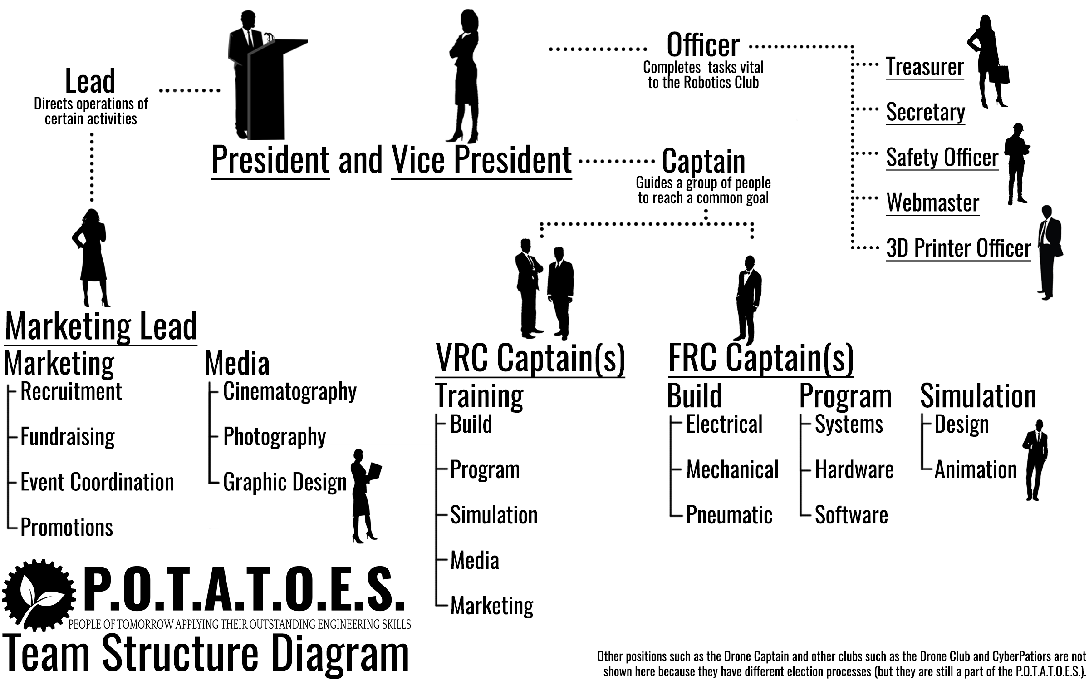
Notes:
What can you do to help?

Slide 5
Communication
Communication is vital for the E.S.H.S. P.O.T.A.T.O.E.S. Robotics Club
Must use communicate with your team at all times and use Slack for P.O.T.A.T.O.E.S. conversations
Visit the GitHub Wiki if you want to learn more about the various competitions
https://github.com/eshsrobotics/database/wiki

Slide 6
Mandatory Attendance
For any part of the Robotics Club you participate in, attendance is mandatory
Every day, sign the attendance sheets with a date, sign in time, and a sign out time
As a member, you must inform other officers that you cannot make it to a meeting
Individuals can “miss” up to two non-consecutive meetings; any more misses might cause the individual to be removed from the club

Slide 7
Rules
Respect and treat club members the way you would want to be treated
Do not use power equipment without appropriate supervision from mentors or faculty
No throwing or eating in the lab
Goggles are required when building in the lab area
Contact a teacher immediately if something breaks or someone gets hurt
Clean up the lab during the last 30 minutes of the meeting

Slide 8
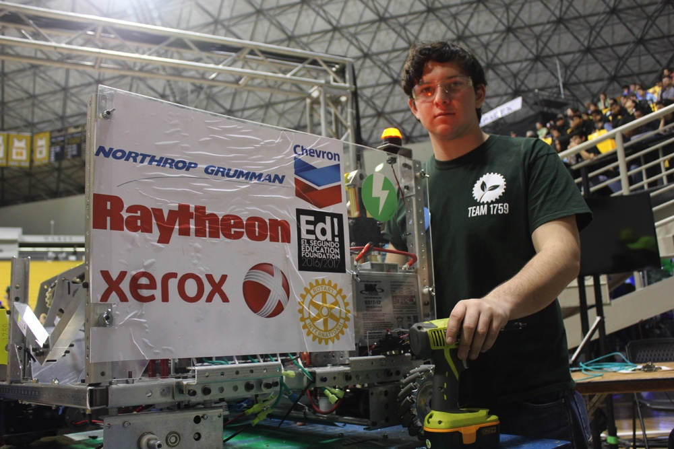
Sponsors
El Segundo Rotary Club
Ed! Foundation
imFORZA
Xerox
Northrop Grumman
Raytheon

